Slide 1
Introduction
Welcome to Hungry Travel Nepal Website
Aayush Aryal
Aalok Das
Ankit Basyal
Bibek Raj Joshi
The website includes designing the layout, styling and interactive elements to provide an engaging and user-friendly experience.
Hungry Travels Nepal.com is a website that serves the people a platform to experience the adventure in Nepal.
The website is thoughtfully designed to increase tourism in Nepal and establish the great adventure and tourism sector's development in Nepal .
It aims to help the government to generate the revenue from tourists.

Slide 2
Features and functionality
Our Travel website is dedicated to those who are interested in adventure. We have various adventure services on our website. The home page welcomes the user and introduces the website and highlights its key features. It contains a menu that links to other sections of the website.
We have different features in our website like the users can explore the adventurous places in Nepal and they can choose the various adventurous destination within Nepal.
Users can easily reach out to the website owners and mention their queries if any. Also there is a contact number and location is available in the contact us page. The users have to submit their details in the contact us section.
Reference sources are mentioned in the website so that the user can go through the books if they have any queries. Provide a list of reference books with title, authors and description.

Slide 3
Technology Used
There are altogether three technologies used in our Hungry Travel Nepal website. They are HTML, CSS and JavaScript.
HTML
We have created the websites skeleton via html and used various elements to create a structure of our website.
CSS
CSS is used for decorating the page to make it look more beautiful. Each page has been decorated with different color combinations. We have also implemented animation in our website via CSS.
JavaScript
We used the Javascript on our website for validating the login form and signup form. Also it is used in our website in home while we are scrolling the webpage in the service section reveals.

Slide 4
Problems Found Lesson Learned
While working on the project we faced a lot of problems along the way that we had to tackle. At the beginning we were unclear about the goals on what type of website to create. Some problems are mentioned below:
Communication issues
There was ineffective communication among team members which led to delay of the work further more. We found that unless we had open communication among team members the work would not move further.
Time management
Poor time management led us to rushed work and decreased project quality. Even though there was not tight deadline due to exams between the time periods we were not able to focus properly on the project which led us to rushed work but we managed to complete it within the time period.
Inadequate planning
Another issue we faced was inadequate planning. We underestimated the importance of detailed planning and this led to missed tasks and confusion. We learned that through planning and assigned responsibilities was absolutely crucial.
Lack of documentation
Poor documentation was another problem we faced as we didn’t first share and keep records of the progress and the changes in project and programs which led to wasted time. We quickly learned the importance of maintaining the documents and share it with team members

Slide 5
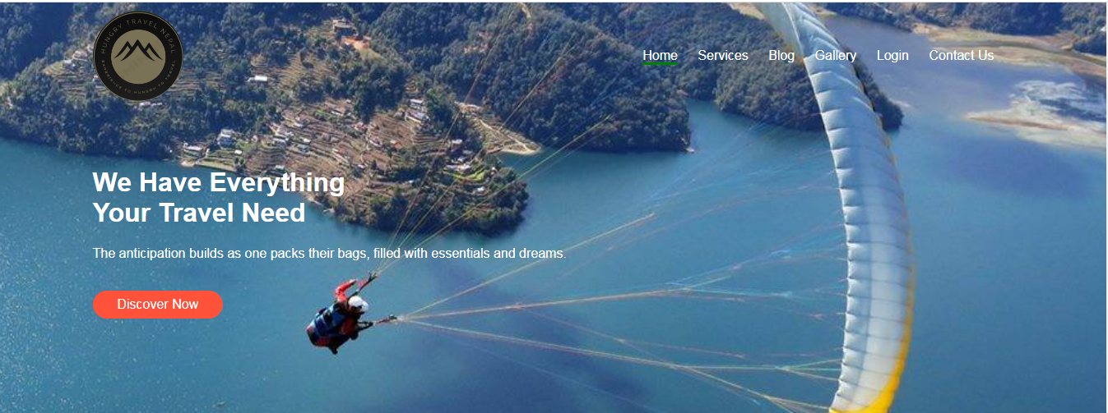
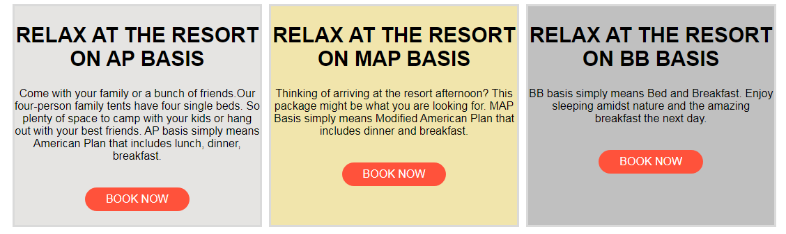
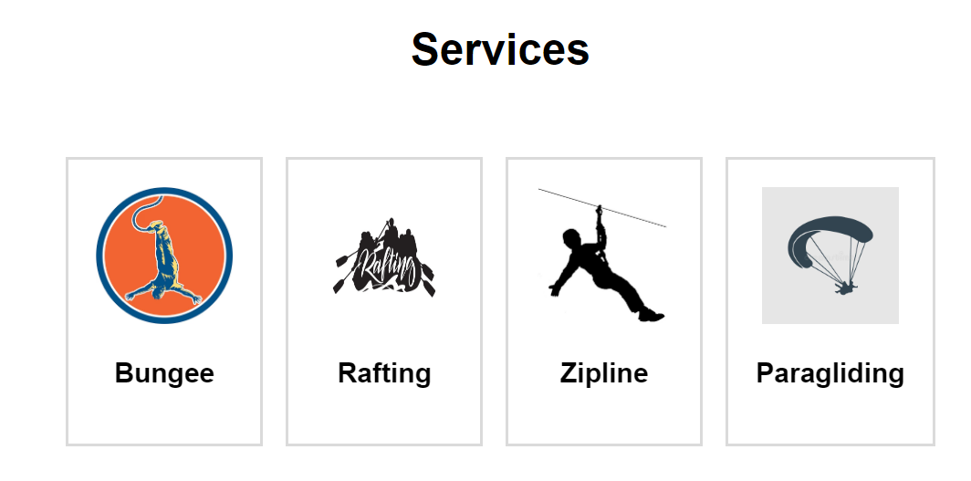
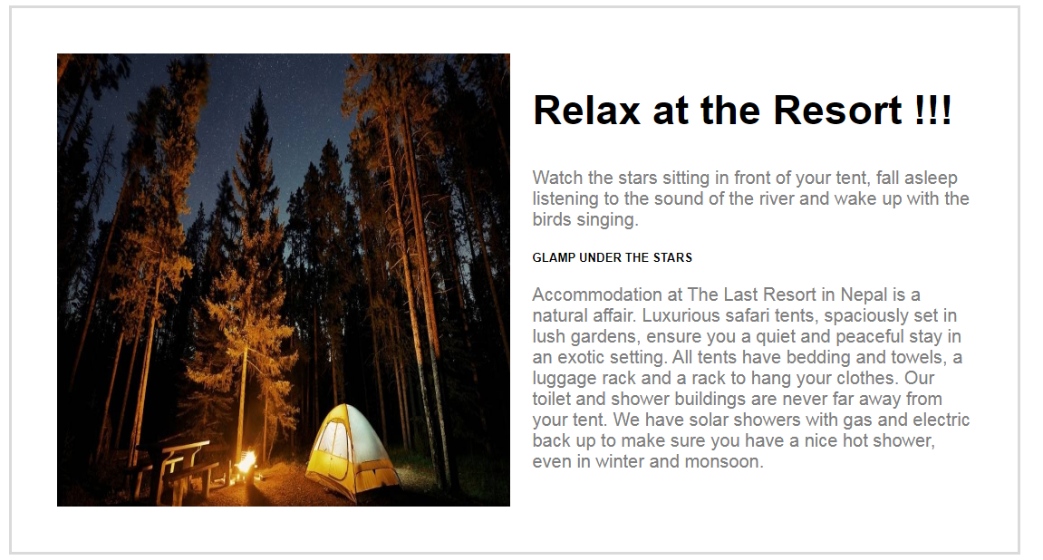
Home Page
At the beginning we have the logo and the navigation links that takes users to different pages in our website.
The home page contains the image slider and service section also.
In the end of home page we have different basis of staying at the resort.

Slide 6
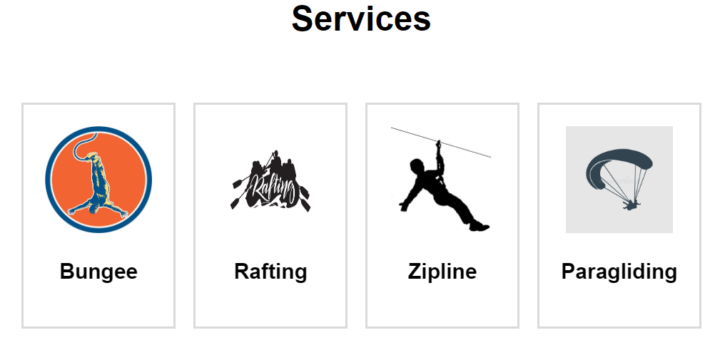
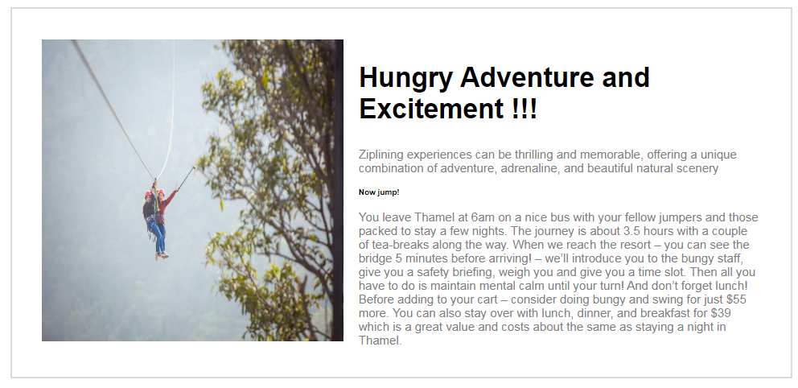
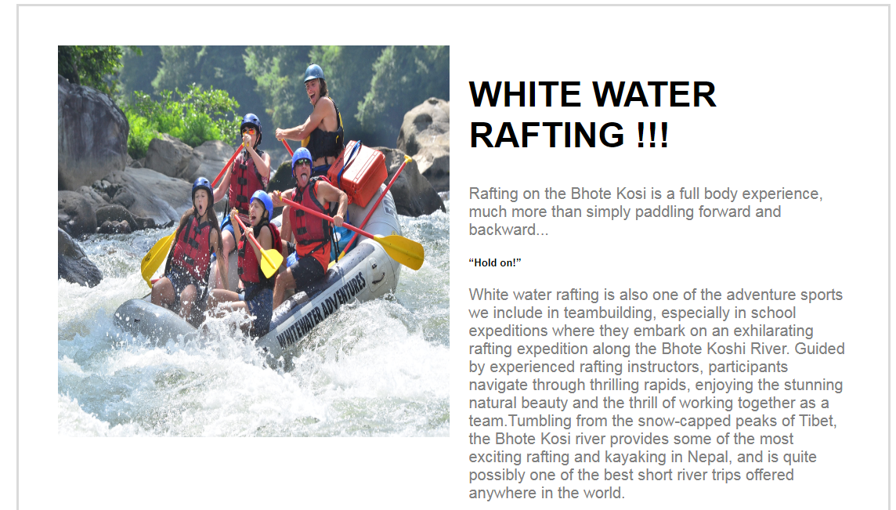
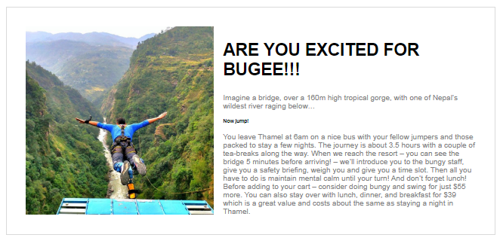
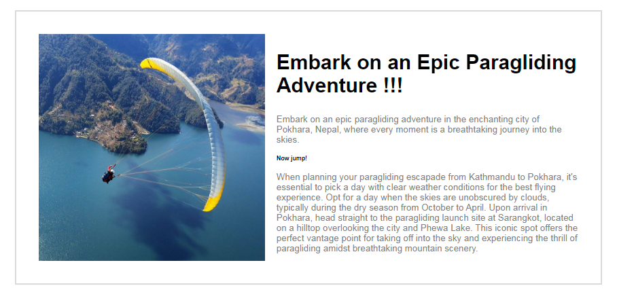
Services Page
The services page includes Bungee, Rafting, Zipline and Paragliding . We provide adventure in those fields with high security.
We have skillful and trained crew which ensures the proper security in our services
The services page provides details about adventure and what type of adventure the customer wants.

Slide 7
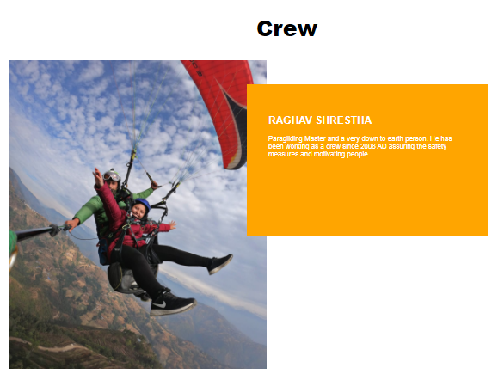
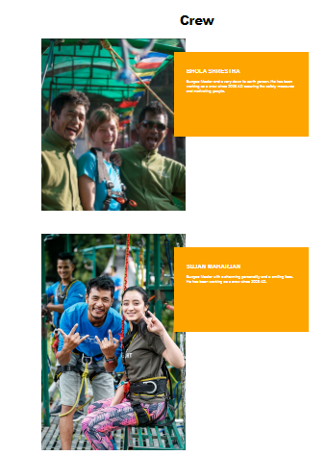
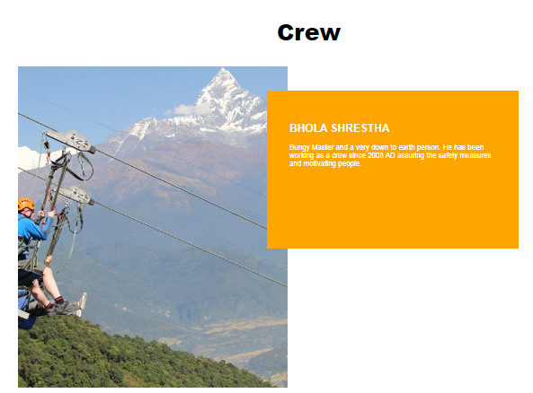
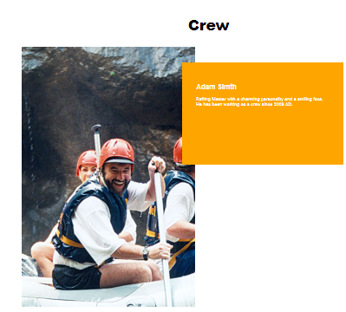
Crew Members
The crew members are the real heroes who take such adventurous risk to make customer happy and feel them secure and comfortable.

Slide 8
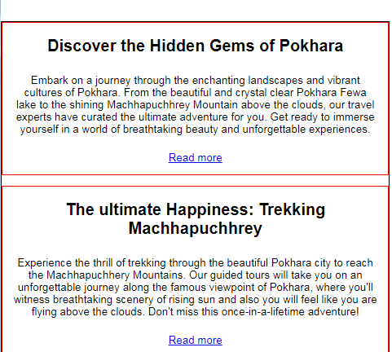
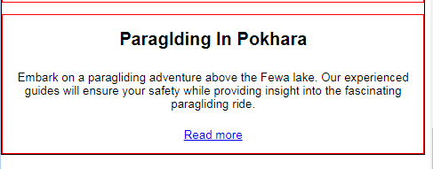
Blog Page
The blog page is simply filled with some headlines about the famous places.
It provides the customer or user to get latest headlines or the news about our page and services.
Also the user will be able to get the knowledge about the places before travelling. Which will help them to explore more about the selected place.

Slide 9
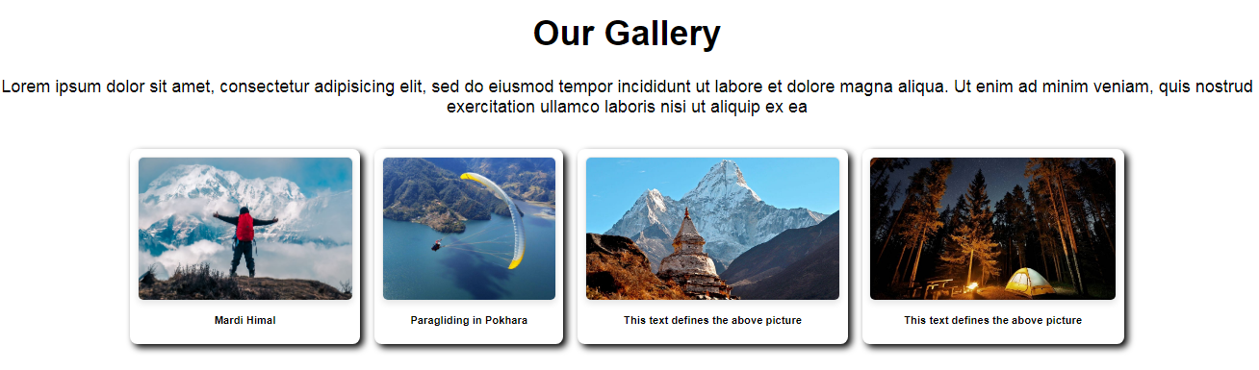
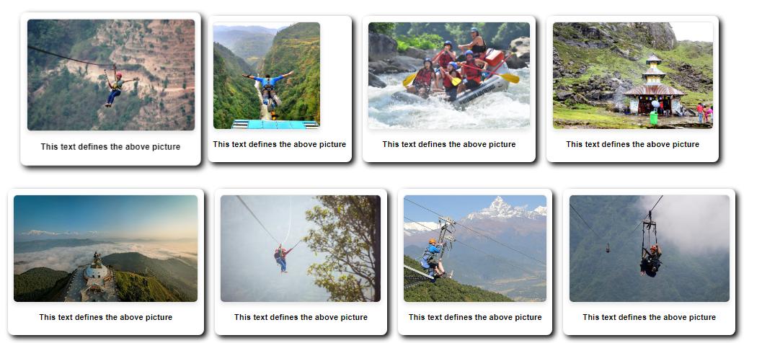
Gallery Page
The gallery page consists of different adventures collection.
In the gallery page user can see our past and recently featured picture which may motive them to try the adventure once.
Gallery page helps the user to explore new places and make them fee to visit once or do the adventure.

Slide 10
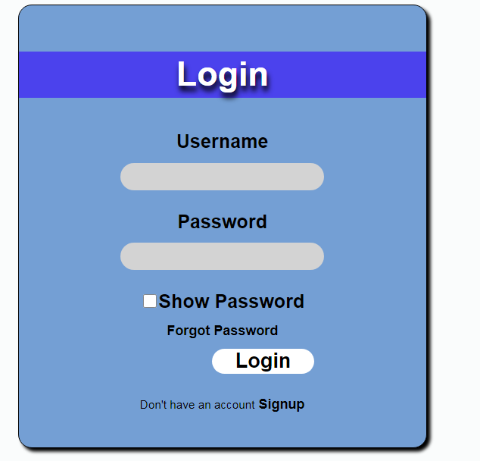
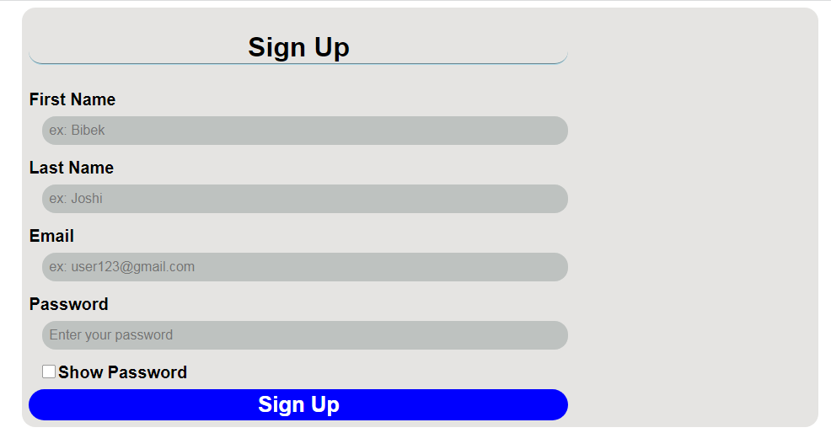
Login and Signup Page
This is our login and signup page.
In this page user can register themselves and will be able get notifications about our new services and offers.

Slide 11
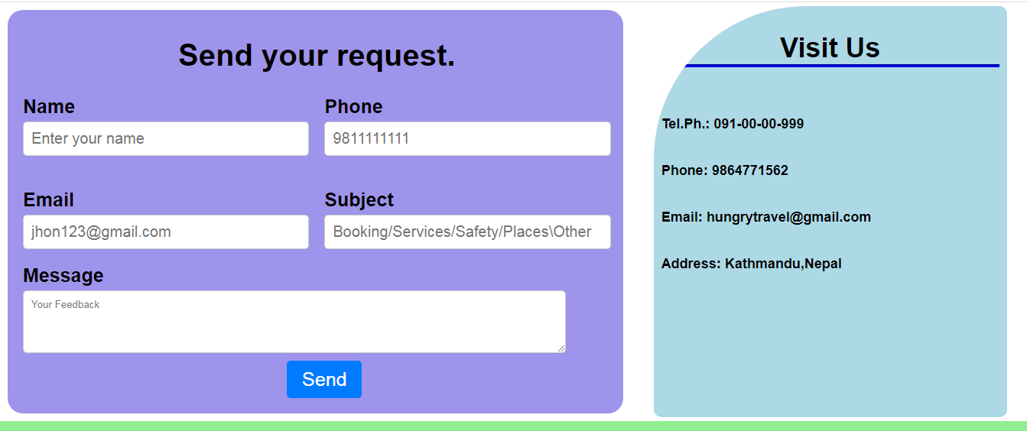
Contact Us Page
The contact us page is created for user's queries.
If the user's have any doubt and misunderstanding about anything they are free to ask us anything.
They have just fill the form and tell us about their queries.

Slide 12
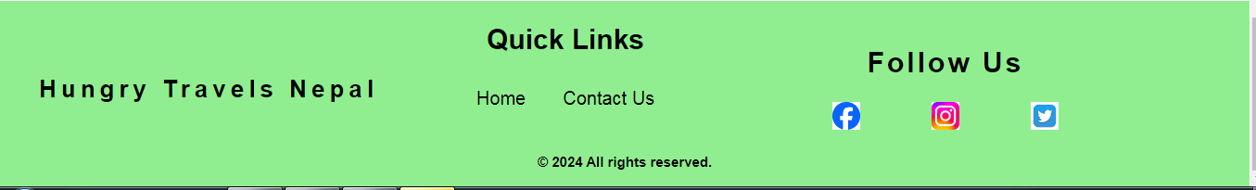
Footer
In the footer section we have provided 2 quick links for our users
Also the users can connect with us in social media so we provided social links for them.

Slide 13
Any Queries?

Slide 14
Thank You!!

